Slide 1
Report segmenter/Bookmarker: inner workings

Slide 2
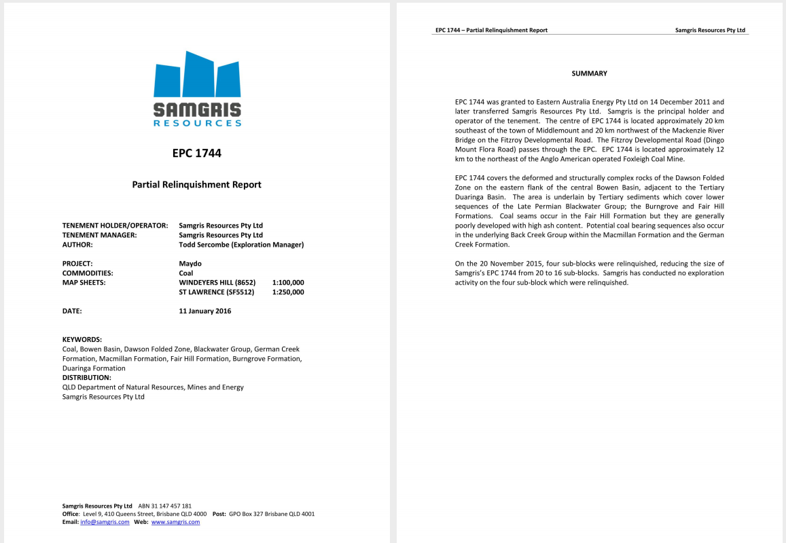
Original Report File
cr_95183_1.pdf
20 pages
2016
Partial Relinquishment Report

Slide 3
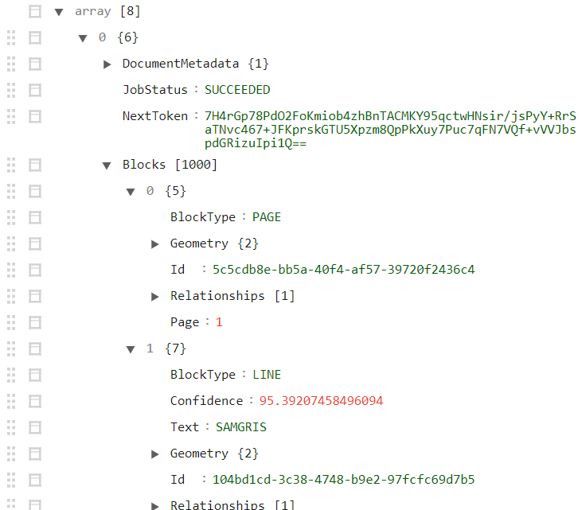
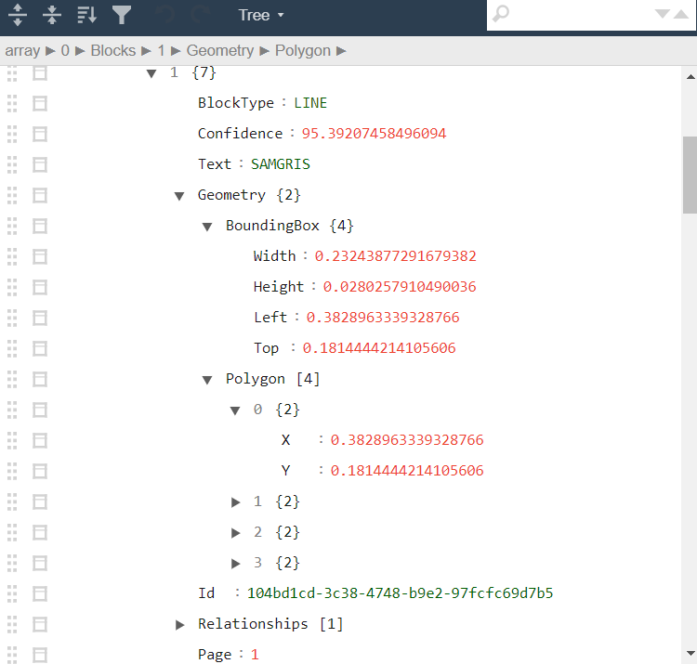
Textract result: JSON
Block types: page, line, word, table, key value pair

Slide 4
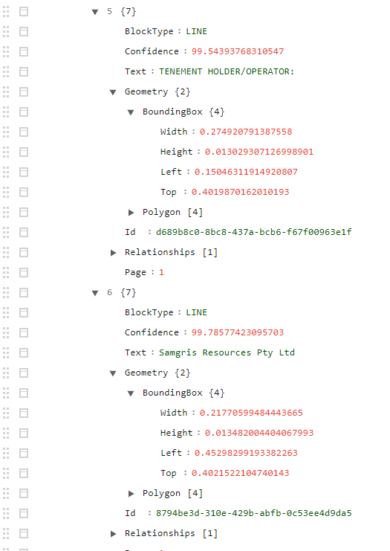
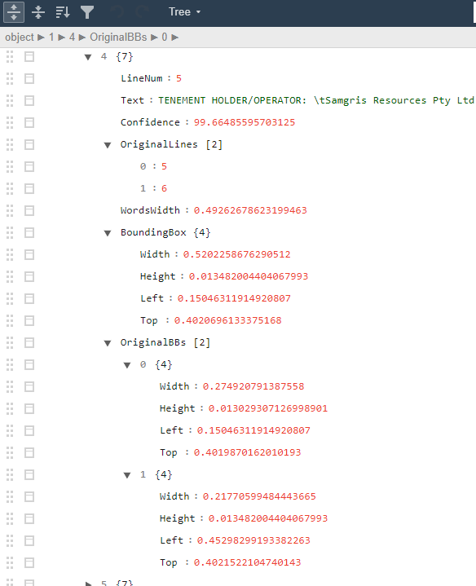
Cleaned/adapted Textract result
Reconstruct lines at the same height to exist in the same line
Remove noise from marginal
Version of the Textract response that is used for everything from now on

Slide 5
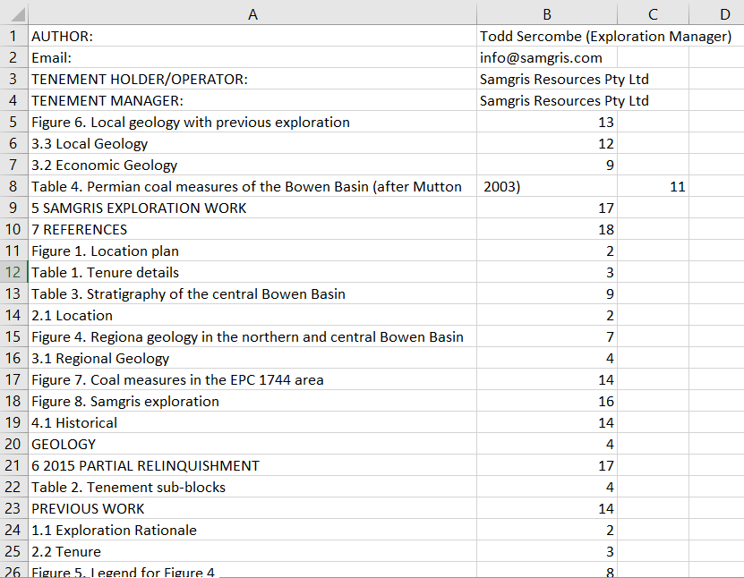
Textract Result: Key-Value pairs

Slide 6
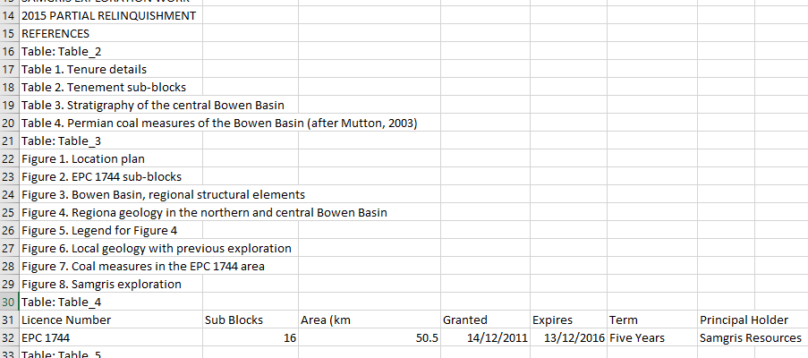
Textract Result: Tables

Slide 7
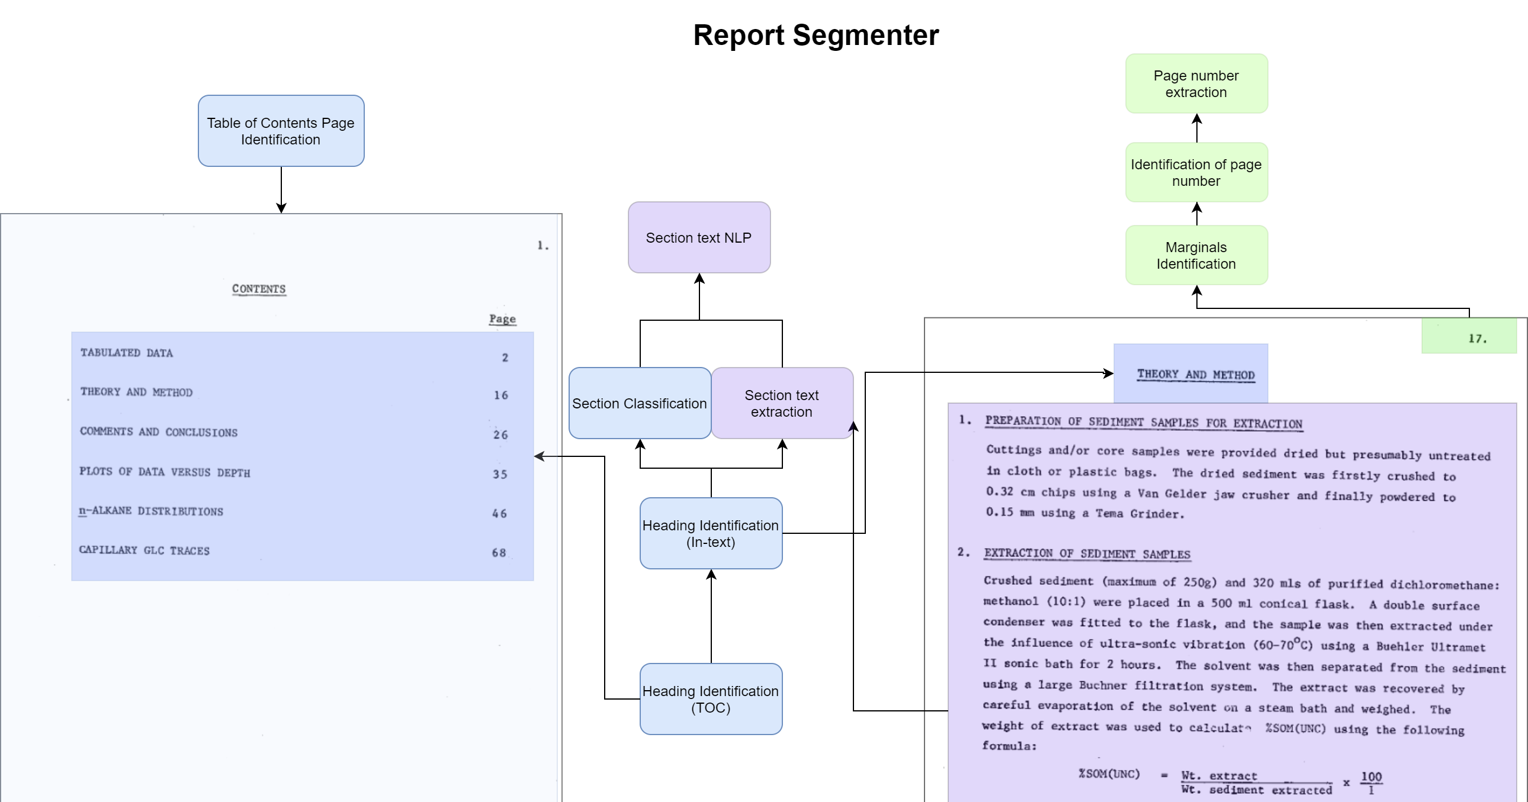
Segmenter flow diagram

Slide 8
Old vs new
“Production” vs “Expansion1” environment
Production – limited dataset in size and variability
Expansion1 – expanded dataset, active learning, and other changes/improvements
Datasets and models will usually be incompatible between the versions because of changes made.
Expansion1 needs more development but Production is pretty refined

Slide 9
Table of Contents (TOC) Page Identification
- Goal: Identify Table of Contents page(s) in report.
- Why? To then extract section headings, which will be invaluable to correctly finding sections in the text.
- Method: Decision Tree working off page features
Features: Page number, number of lines on the page, if the page contains the phrase ‘table of contents’, if the page contains the word ‘contents’
Additional features in expansion1 version: if the page contains the phrase ‘list of’, if the previous page is a TOC

Slide 10
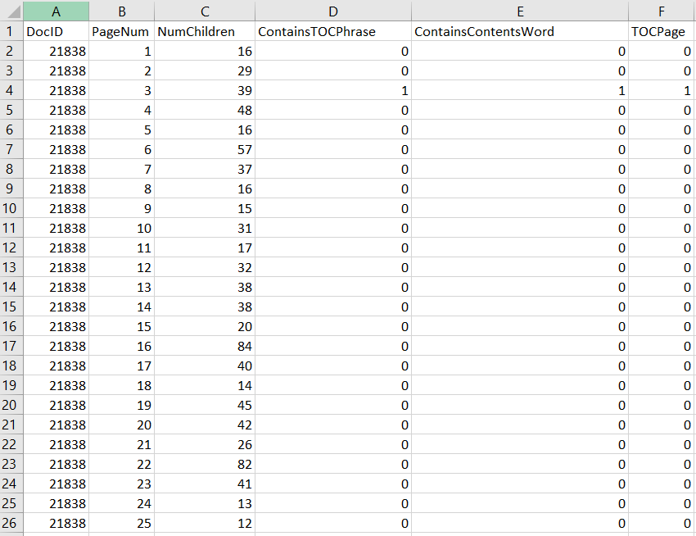
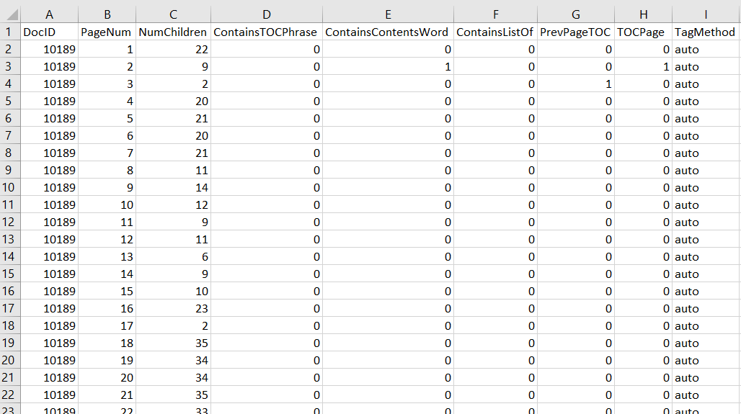
Dataset: TOC page identification
Include legacy and expansion1, talk about why you changed it
But legacy may work better overall
Production version and expansion1 version

Slide 11
Name | Include columns | Model details | Notes | Issues | Improvements
TOC classification | ['PageNum','NumChildren','ContainsTOCPhrase','ContainsContentsWord','ContainsListOf','PrevPageTOC'] | tree.DecisionTreeClassifier() | Could return multiple TOC pages, but currently in search_report only choose the one with the highest proba. | PrevPageTOC attribute, introduced to help find second pages of TOCs that didn't necessarily have the right phrases on them, makes the training and prediction processes longer and more difficult as samples have to be processed on a one by one and sequential basis. ListOf attribute was added at the same time, to help find pages typically coming after the TOC which would list figures, tables, appendices. This type of page is classified as a 2 in comparison to TOC's 1. It was added as it was thought these lists could be useful in the same way, but they should be differentiated from TOCs. Issue: sometimes the TOC contains a ListOf section. This is usually classed as a TOC as that type is more important. Decision tree in production set is very simple. This leads to the title page sometimes being classed as a TOC when it ContainsContentsWord Expansion1 model partially retains this issue: in 30320, the title and toc page have proba of 0.96 and 0.98 to be TOC, making the true result win by a very small margin. | Would be good for the tree to have a rule such that a page has to be above 1 to be a TOC. Expansion1 model may develop this.

Slide 12
Heading Identification (TOC)
- Goal: Identify lines on the table of contents page that describe section headings and subheadings.
- Why? Knowing the headings that appear in the document will make finding them in the text much more reliable, as it’s clear what they’re going to be.
- Method: Neural Network with LSTM layer*
Features: Line Text
Additional features in expansion1 version: Left, Top attributes of line
* May or may not be being used appropriately – not the most experienced with LSTMs

Slide 13
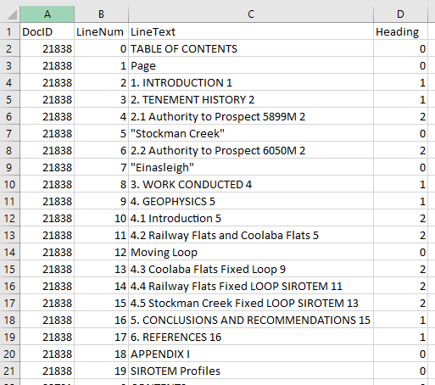
Dataset: Heading Identification in Table of Contents
Production version

Slide 14
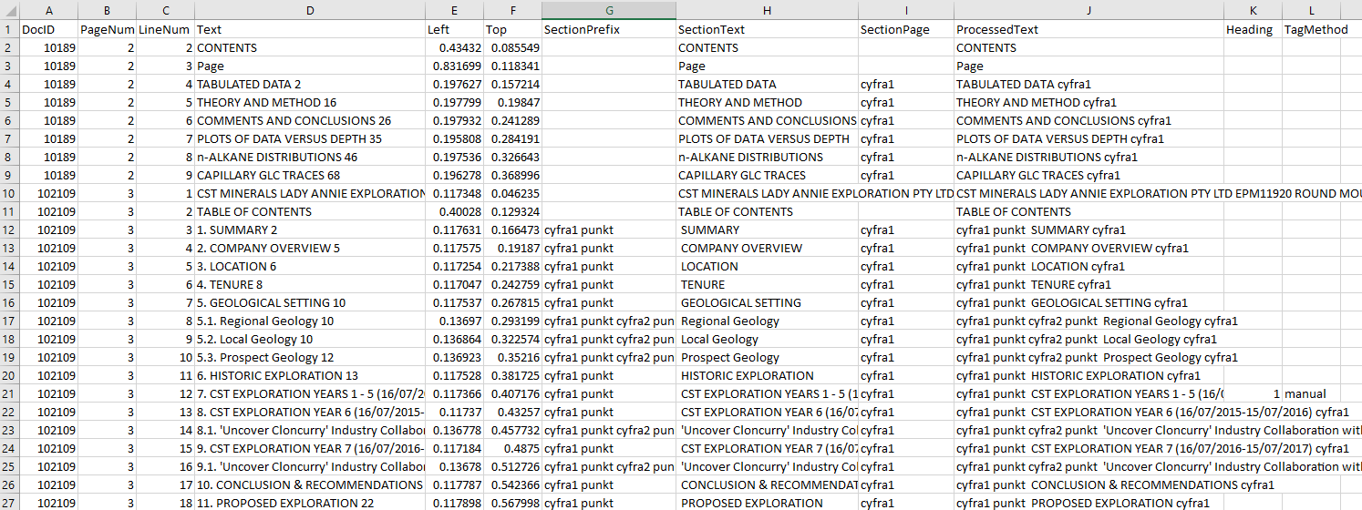
Dataset: Heading Identification in Table of Contents
Expansion1 version
Added Left, Top attributes

Slide 15
Name | Include columns | Model details | Notes | Issues | Improvements
Heading ID TOC | ['Left','Top','ProcessedText'] | ifself.mode==settings.production: lstm=KerasClassifier(build_fn=self.ProdLSTM,batch_size=self.batch_size,epochs=self.epochs, validation_split=0.2) clf=Pipeline([ ('transform',Text2Seq(pad_len=seq_len)), ('lstm',lstm) ],verbose=True) else: lstm=KerasClassifier(build_fn=self.LSTM,batch_size=self.batch_size,epochs=self.epochs, validation_split=0.2) clf=Pipeline([ ('text',ColumnTransformer([ ('transform',Text2Seq(pad_len=seq_len),-1) ],remainder="passthrough")), ('split',FunctionTransformer(split_input)), ('lstm',lstm) ],verbose=True) defProdLSTM(self): model=Sequential() model.add(Embedding(self.max_words,output_dim=256))#self.max_len)) model.add(LSTM(128)) model.add(Dropout(0.3)) model.add(Dense(3,activation='softmax')) model.compile(loss='categorical_crossentropy', optimizer='rmsprop', metrics=['accuracy']) returnmodel defLSTM(self): nlp_input=Input(shape=(seq_len,),name='nlp_input') meta_input=Input(shape=(len(include_cols)-1,),name='meta_input') emb=Embedding(input_dim=self.max_words,input_length=seq_len,output_dim=256)(nlp_input) nlp_out=LSTM(128,dropout=0.3)(emb) x=concatenate([nlp_out,meta_input]) x=Dense(64,activation='softmax')(x) x=Dense(3,activation='softmax')(x) model=Model(inputs=[nlp_input,meta_input],outputs=[x]) model.compile(loss='categorical_crossentropy', optimizer='rmsprop', metrics=['accuracy']) returnmodel |  | Main issue stems from from entries for Figures and Tables also being in the TOC, alongside headings and subheadings. These are hard to handle, especially when the relevant word ('figure' or 'table' or similar) isn't in the line. The fact that's it's not a heading must be taken from the context of lines above it. Goal is to lean towards finding false positives rather than false negatives - to find headings at the expense of finding non-headings. This is not reflected in the results. Model has a hard time distinguishing between headings and subheadings. I think if a CNB model with ngram_range=((1,2)) was used, this would be more accurate, but an LSTM model was chosen to move forward with for its ability to remember context. I do want that quality, so I think the LSTM model should just be improved, if possible. If not, would revert to the simpler CNB. | Need a model which can take in the context around lines to classify them - eg. note that the line, "Map of XYZ" is a few lines below the heading "List of Maps" - and is thus not a heading. Words are only indicated as integers, then the Left and Top attributes appended to the end of the sequence. I think less weight could be put on the words in relation to these other attributes. Or the words could be represented as tfidf vectors for more weight. As the models use LSTMs, there is a lot of tweaking that can be done and I'm not sure how to do it. Trial and error testing or third part expertise is required. I don't want to annotate non-headings as headings, even if it would help heading accuracy, as I don't want to split sections in the report if there is a figure in the middle, and all of a sudden that becomes a new sections. This wouldn't matter for bookmarking but would break section text extraction.

Slide 16
Heading Identification (in-text)
- Goal: Find section headings in the document text
- Why? To know the starting points of sections, to be able to extract section text.
- Method: Pipeline of complement Naïve Bayes (for text) and then Random Forest for CNB result + other features
Features: Page number, line text, ration of number of words on line to width of line, width of line, height of line, if the line contains a number, word count, how well the line matches a heading from TOC, if the heading that it matches best is a heading or sub-heading

Slide 17
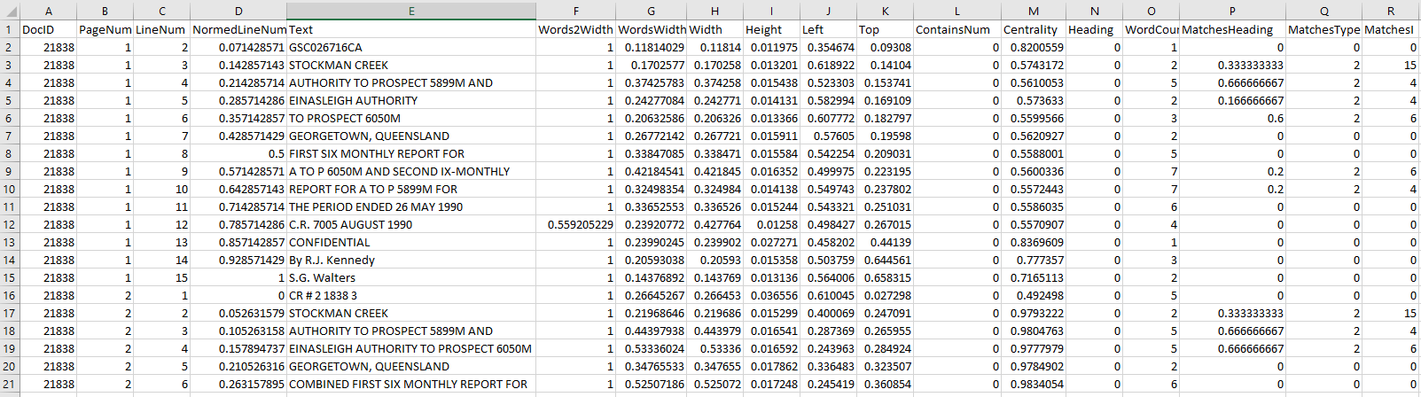
Dataset: Heading Identification In-Text

Slide 18
Name | Include columns | Model details | Notes | Issues | Improvements
Heading ID In-text | ['PageNum','Text','Words2Width','Width','Height','Left','ContainsNum','WordCount','MatchesHeading','MatchesType'] | if'no_toc'inmodel_file: limit_cols.extend(['MatchesHeading','MatchesType']) estimator=Pipeline([ ('text',ColumnTransformer([ ('cnb',Text2CNBPrediction(),1) ],remainder="passthrough")), ('forest',RandomForestClassifier()) ],verbose=True) classText2CNBPrediction(TransformerMixin,BaseEstimator): deffit(self,x,y): ifisinstance(x,np.ndarray): x=pd.Series(x) text_clf=Pipeline([ ('n2c',Num2Cyfra1()), ('tf',TfidfVectorizer(analyzer='word',ngram_range=(1,2))), ('cnb',ComplementNB(norm=True))]) self.text_clf=text_clf.fit(x,y) self.feature_names_=self.text_clf['tf'].get_feature_names() self.y_=y returnself deftransform(self,data): pred=self.text_clf.predict(data) returnpd.DataFrame(pred) defget_feature_names(self): returnself.feature_names_ classNum2Cyfra1(TransformerMixin,BaseEstimator): deffit(self,x,y=None): returnself deftransform(self,data): ifisinstance(data,np.ndarray): data=pd.Series(data) data=data.apply(lambdax:heading_id_toc.num2cyfra1(x,remove_words=False)) returndata defcontains_num(x): ifre.search('^[0-9]+.*?\s\w',str(x)): return1 else: return0 |  | Think this one works pretty well. Extremely reliant on Heading ID TOC to be correct though, so if that one's broken, this one is.

Slide 19
Marginals Identification
- Goal: To identify lines on the page which are a header or footer.
- Why? To exclude these lines from section text, and to later identify page numbers
- Method: Random Forest
Features: Page number, normalised line number, ratio of words to width, width, height, left, top, if the line contains a number, if the line contains a tab character (this indicates that a line was reconstructed), if the line contains the word ‘page’, the centrality of the line

Slide 20
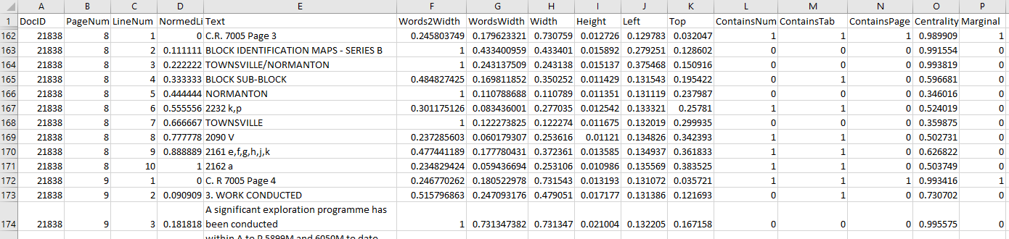
Dataset: Marginals Identification

Slide 21
Page Number Identification
- Goal: To determine whether a marginal line contains a page number.
- Why? To later extract that page number. To know if there’s one to extract.
- Method: Neural Network with LSTM layer
Features: transformed line text
Each word on a line is replaced by one of the following, representing its meaning:
word, tab (tab character), page (word == ‘page’), appendix (word == ‘appendix’), smallNum (one or two digit number), mediumNum (three digit number), bigNum (number larger than three digits), month (word == one of the months), mix (a mixture of alphanumeric characters)
Why? To learn the structure of lines which contain page numbers by the types of words that appear, not the exact words.

Slide 22
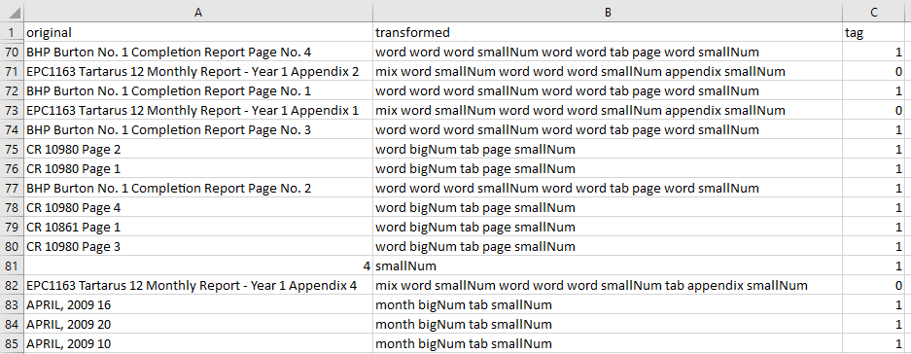
Dataset: Page Number Existence

Slide 23
Page Number Extraction
- Goal: To extract a marginal line’s page number.
- Why? To confirm this against section page number on the Table of Contents (if they appear both there and in marginals).
- Method: Neural Network, trained to find the position of the page number
Features: line text transformed in the same way as for page number identification

Slide 24
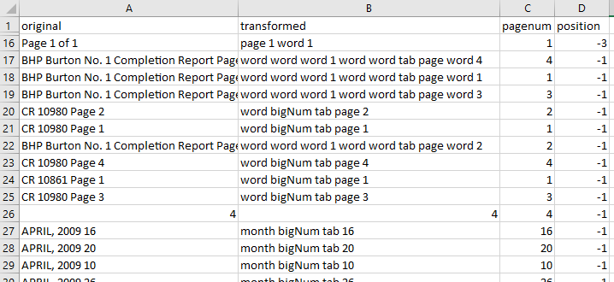
Dataset: Page Number Identification

Slide 25
Name | Include columns | Model details | Notes | Issues | Improvements
Marginals classification | ['PageNum','NormedLineNum','Words2Width','WordsWidth','Width','Height','Left','Top','ContainsNum','ContainsTab','ContainsPage','Centrality'] | ensemble.RandomForestClassifier() | Not really in use but works. | Legacy annotations probably don't include multi-line marginals. Or, they may include them, but have them be incorrectly annotated. | While there are similarities across reports, the identification of marginals can be extremely contextual to the report. If a model could be used that took into account the report context, that would be great.
Page identification | ['original'] | lstm=KerasClassifier(build_fn=self.LSTM,batch_size=self.batch_size,epochs=self.epochs, validation_split=0.2) estimator=Pipeline([ #('transform1',ColumnTransformer([ ('transform_text',FunctionTransformer(transform_text_wrapper)),#0) #],remainder="passthrough")), ('transform2',Text2Seq(classes=2)), ('lstm',lstm) ],verbose=True) defLSTM(self): model=Sequential() model.add(Embedding(self.max_words+1,output_dim=self.max_len))#256)) model.add(LSTM(128)) model.add(Dropout(0.5)) model.add(Dense(1,activation='sigmoid')) model.compile(loss='binary_crossentropy', optimizer='rmsprop', metrics=['accuracy']) returnmodel | Not in use If in use, would be a step in the marginals->pageid->pageextraction pipeline to find a page's page number and match it to those provided in the table of contents to verify if headings have been found correctly
Page extraction | ['original'] | nn=KerasClassifier(build_fn=self.NN,batch_size=self.batch_size,epochs=self.epochs,validation_split=0.2) clf=Pipeline([ ('transform_text',FunctionTransformer(transform_text_wrapper)), #('num2word',FunctionTransformer(lambdax:num2word(x))), ('transform',Text2Seq(classes=self.num_classes,pad_len=self.max_len)), ('nn',nn) ],verbose=True) | Not in use | Model is kinda hacked together. Page numbers in the text may not exist (eg. because of scanning that cut them off), or may not correlate to page numbers given to heading in the TOC because the report was put together incorrectly.

Slide 26
Section classification
- Goal: To classify headings as belonging to one of several major types.
- Why? To get able to get a heading type out of a report without having to match on exact text. Eg. getting a ‘Work Completed’ type heading – many different wordings are used for this across reports.
- Method: Complement Naïve Bayes
Features: Line text

Slide 27
Figure Page Identification
- Goal: To identify pages which majorly contain figures/images
- Why? To exclude the content of these pages from section text, as it will be nonsensical and just noisy.
- Method: Random Forest
Features: page number, (median, average, range, interquartile range) of confidence of lines on page, median line length, if the page contains the word ‘figure’, if the page contains the pattern r‘Figure\s\d+\.*\s*\w*’, and the normalised line number of the best ‘figure’ line
Method largely works off confidence of text on these pages being far less good and more variable than on pages of regular text.

Slide 28
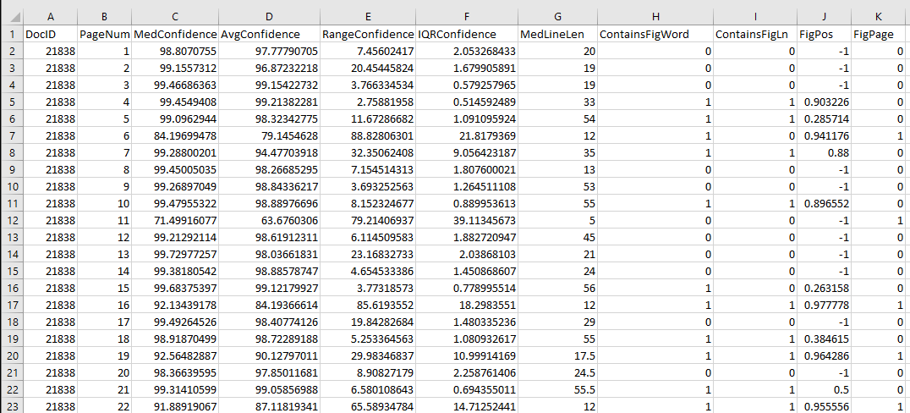
Dataset: figure page classification

Slide 29
Name | Include columns | Model details | Notes | Issues | Improvements
Fig classification | ['PageNum','MedConfidence','AvgConfidence','RangeConfidence','IQRConfidence','MedLineLen','ContainsFigWord','ContainsFigLn','FigPos'] | RandomForestClassifier() | Not really in use but probably works? Need to check | Not sure what metric to use in classifying a page as 'figure' - is it when the page mostly contains a figure, contains a named figure, or contains a figure at all? Is a table a figure? In legacy annotation, the logic has been that if a figure dominates a page, it is a figure, and tables are not figures. | The current model uses pretty simple attributes, may need to become more complex for Exapansion1 and once needs for what it should do solidify.

Slide 30
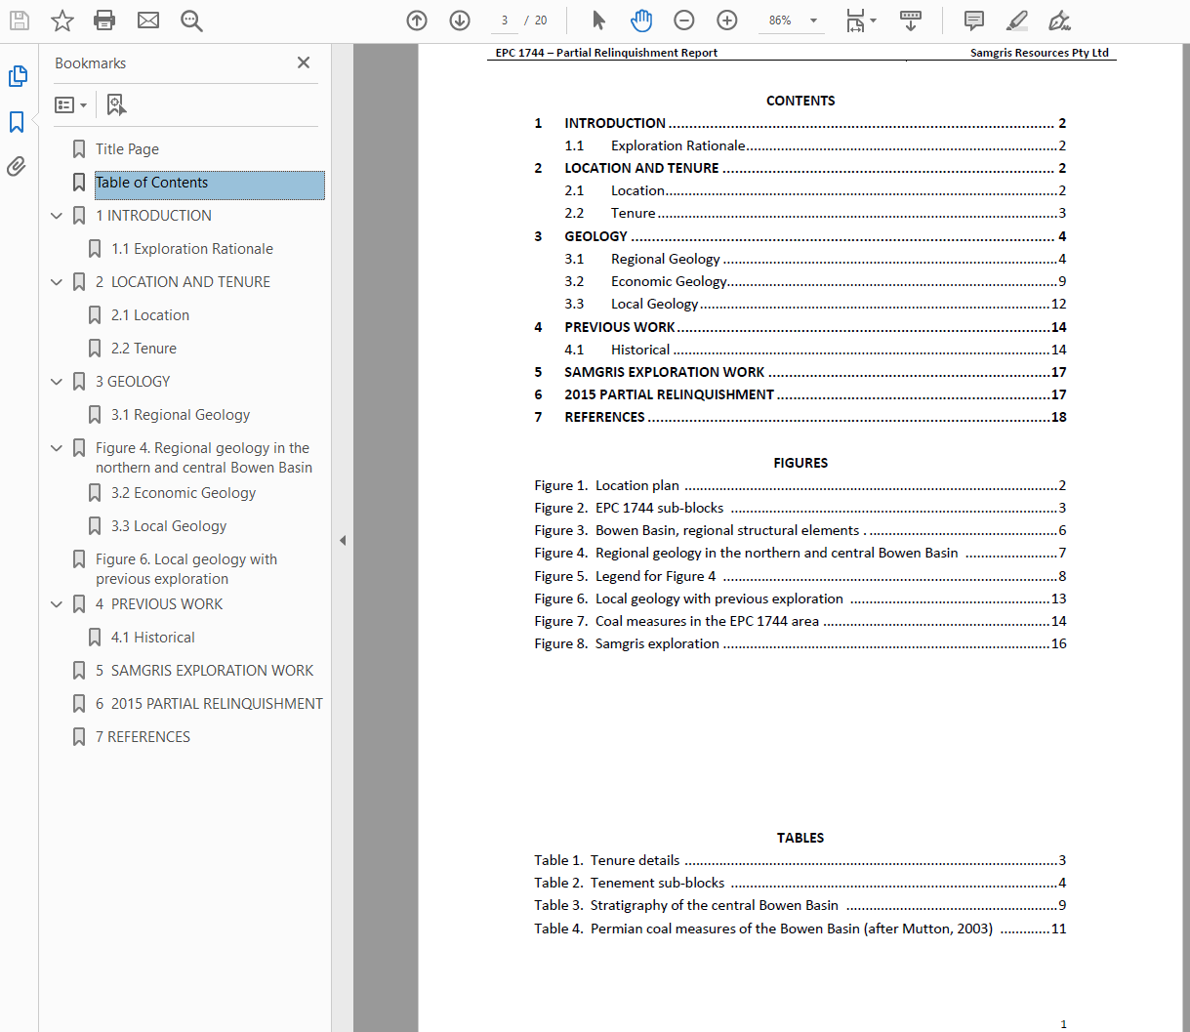
Bookmarked pdf

Slide 31
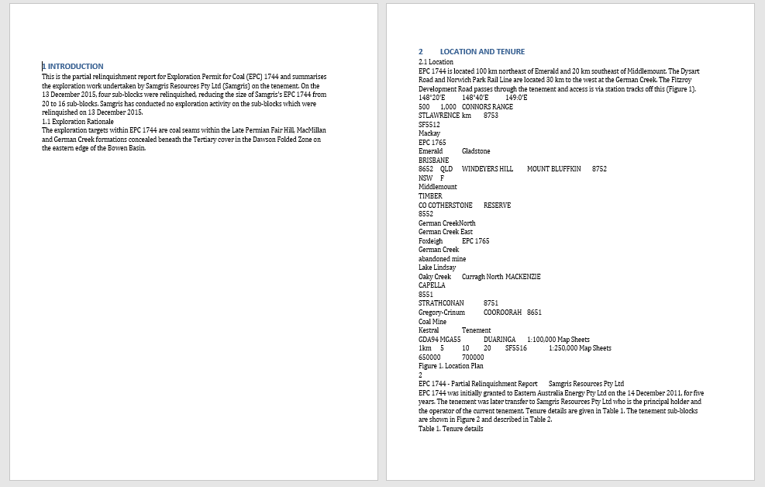
Text sections

